Slide 1

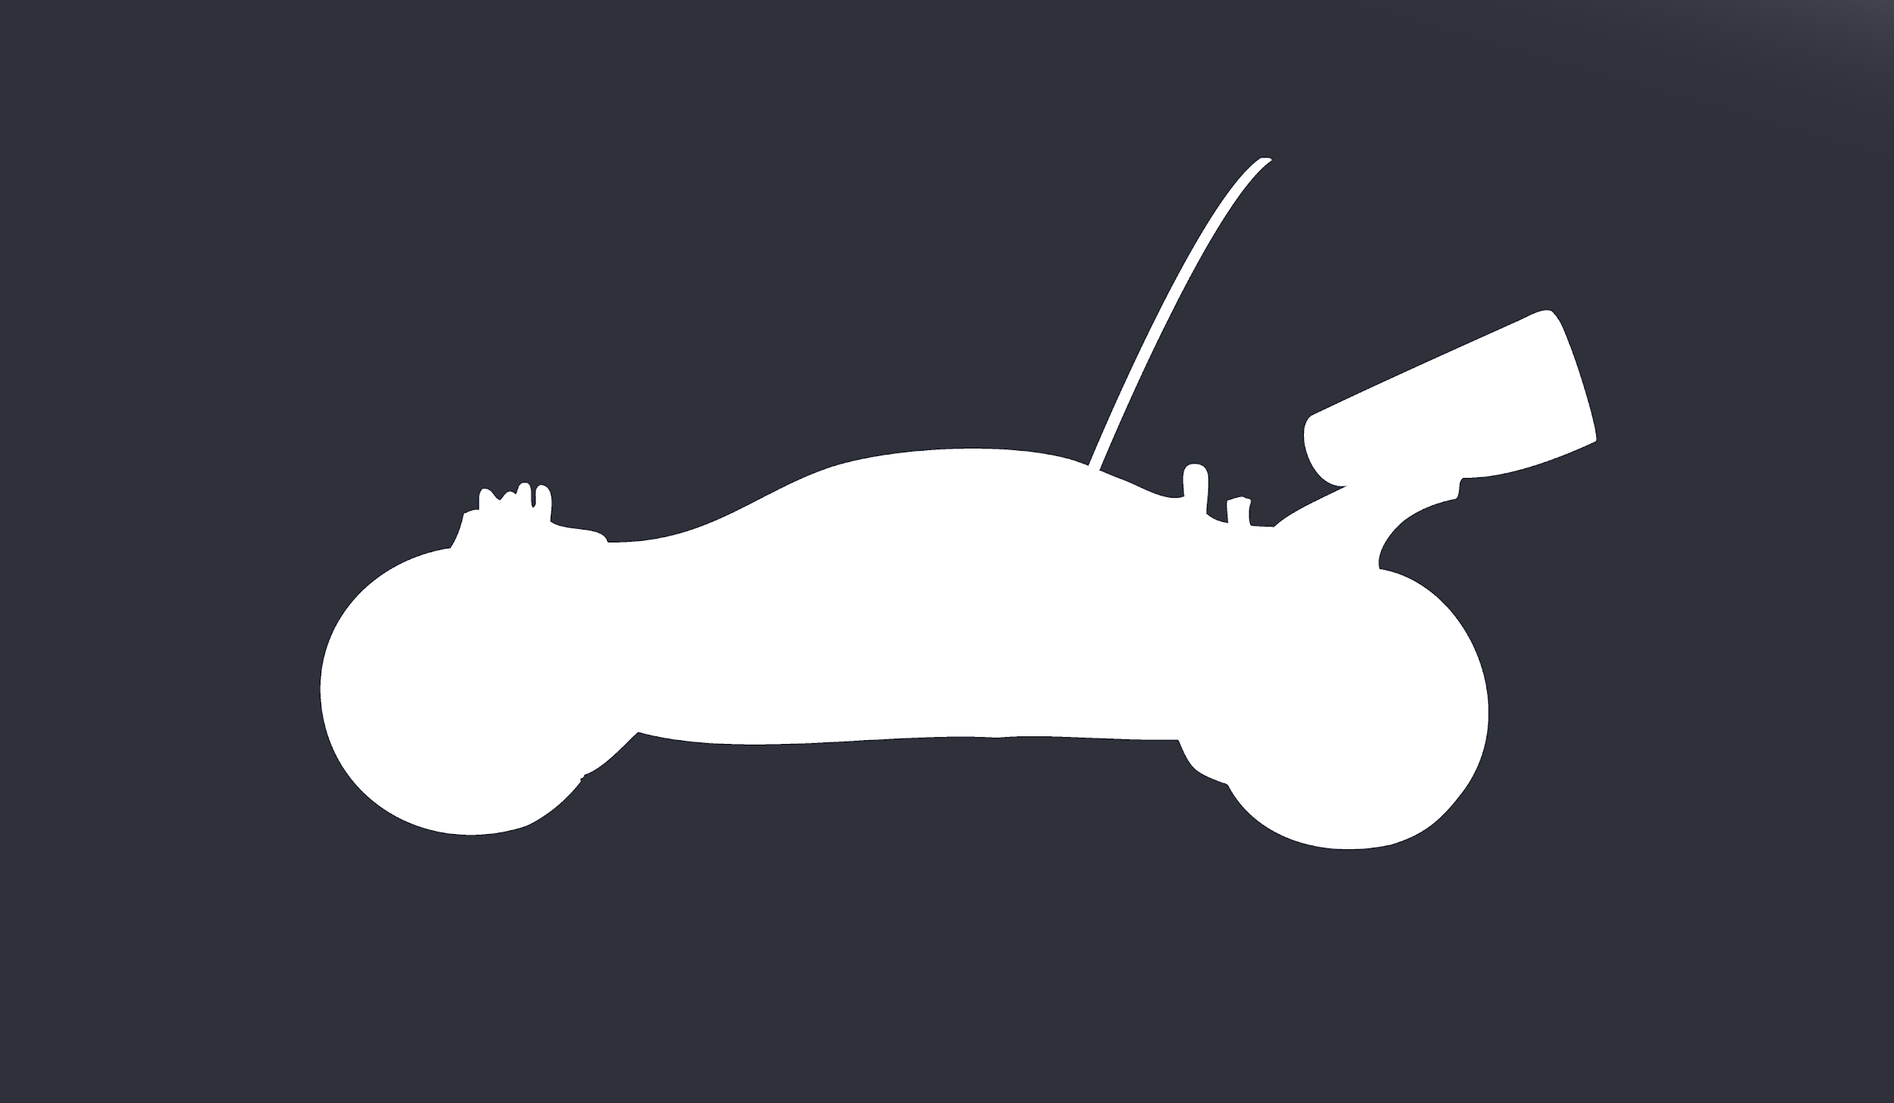
FPGAng’s
Controlled/Autonomous Rover
Ganquan Wen
Zisen (Jason) Zhou
Ben Brown
Nicholas Arnold
Mohammed Uddin

Slide 2

Goal - What do we want to accomplish?
Implement a “RC” Car using an FPGA with distinct modes
Controlled
Autonomous
Add unique peripherals
Bluetooth for controls
Ultrasonic Sensor/Light Sensor to detect environment
Motors and accelerometers to drive the rover
Dedicated Android/iOS App
Connect to rover
Switch between modes
Navigate controls on rover

Slide 3
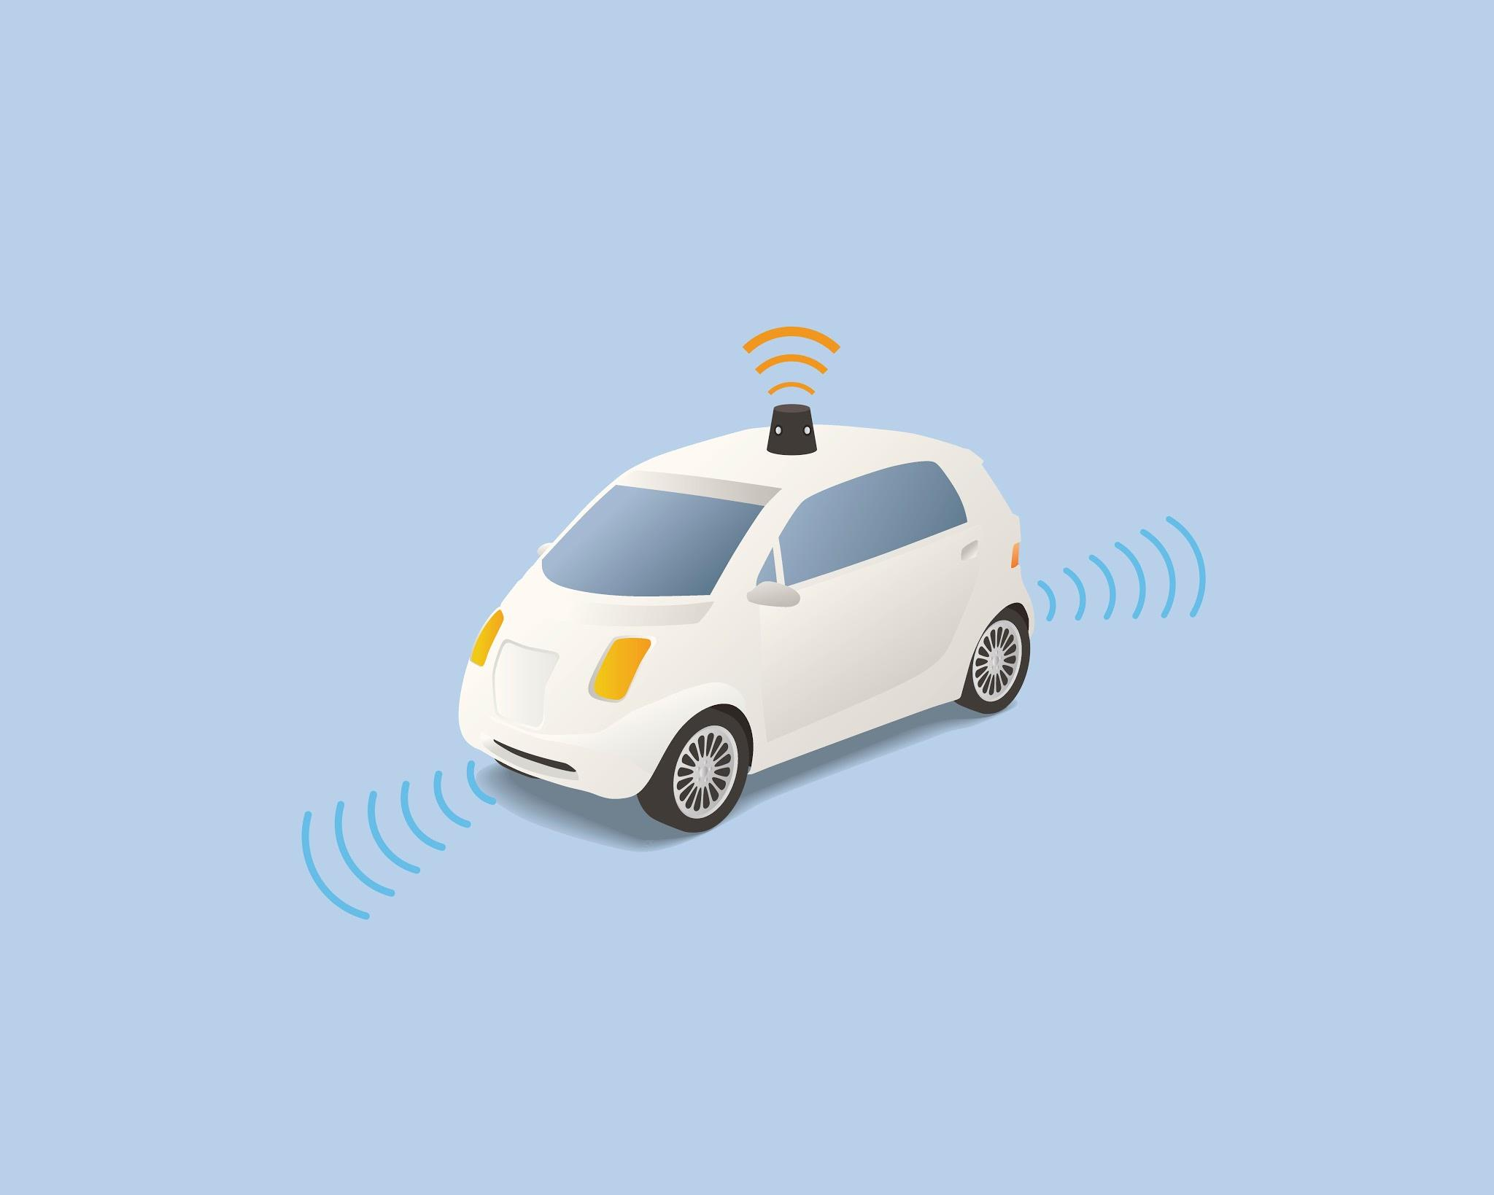
Why is is this interesting?
Self-driving cars are gaining popularity and feasibility
Can we implement this idea using FPGAs?
Implementing both remote bluetooth control & input from distance sensors!
Navigating obstacles
Sense our surroundings to make decisions about direction
With more time, able to detect lines (simulate highway driving)
App control
An iOS/Android application will send signals to the car to control speed and steering

Slide 4
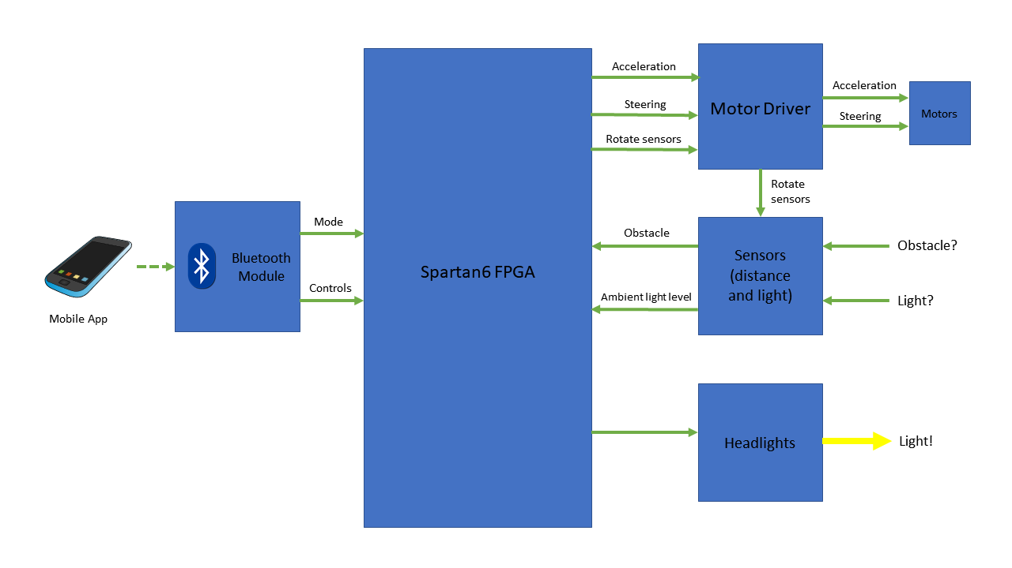
High Level Diagram

Slide 5
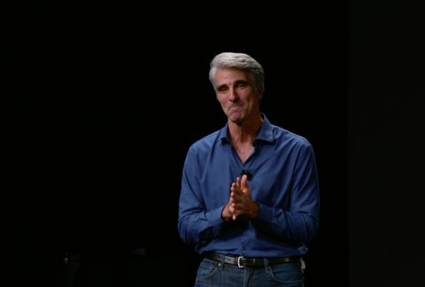
Demo
Rover App
Turn on the lights when room is dark (sensors in autonomous)
Switch between modes
Bluetooth controlled mode
Use app to control the car to move around
Autonomous mode
Drive itself
Stop at the obstacles
Create a course

Slide 6


Materials Needed
Car Base (including wheels, gears, axles)
FPGA board (Spartan 6)
Bluetooth module (HC05)
Sensors/Emitters (light(Photoresistor), ultrasonic(SEN-13959))
Power (battery)
3 Motors (one to rotate/move the sensors and two to drive the wheels)
Motor driver IC (L239D)
Wires , Boards, GPIO, and Soldering kit

Slide 7

Challenges we may face & Back up Plan
Autonomous mode
May find that simply detecting things in front of the car is too “dumb”
Could use sensors for all four directions, and move based on distance from obstacles on all sides
Front sensors detect first > side sensors used after form making movement direction
Many peripherals
May run into problems integrating so many different peripherals into one system
Potential timing issues between peripherals
Motor configuration
Balancing maneuverability and power consumption
Added complexity of different motor configurations

Slide 8
Timeline and Project Landmarks
First Presentation
Order Parts
Controls Code
Materials Obtained
Motors Steering Controls Implemented
Functioning App with Bluetooth
Autonomous Mode
& Sensors
Integration and testing phase
Final Presentation
Demo
Feb 15th March 1st March 15th March 22nd April 1st April 15th Apr. 26th May 1st

Slide 9
General Task Overview
Tasks | Responsible
Motor Implementation | Ben
Sensors/Controls | Jason & Gan
Bluetooth Connectivity/App Design | Mo & Nick
Project Documentation | Mo
Video Presentation | Nick
Debugging & Integration | All Members

Slide 10


Feedback is welcome!

